Slide 1
DATABASE MANAGEMENT SYSTEM
21CSL55
Normalization: Database Design Theory
Module: 5
Prepared by:
Ch.Manasa, Dept of ISE, CMRIT

Slide 2
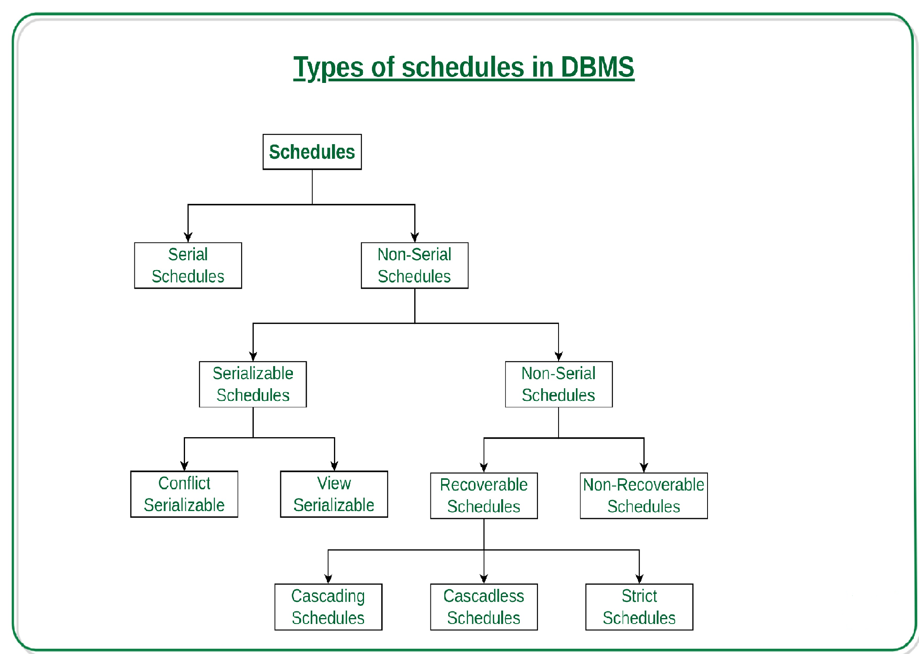

Slide 3
Serial Schedules:
  Schedules in which the transactions are executed non-interleaved, i.e., a serial schedule is one in which no transaction starts until a running transaction has ended are called serial schedules.
  In Serial schedule, a transaction is executed completely before starting the execution of another transaction. In other words, you can say that in serial schedule, a transaction does not start execution until the currently running transaction finished execution.

Slide 4
Non-Serial Schedule
This is a type of Scheduling where the operations of multiple transactions are interleaved. This might lead to a rise in the concurrency problem.
If interleaving of operations is allowed, then there will be non-serial schedule.
It contains many possible orders in which the system can execute the individual operations of the transactions.

Slide 5
Serializable
The non-serial schedule is said to be in a serializable schedule, only when it is equivalent to the serial schedules, for an n number of transactions.
It is mainly used in the Non-Serial scheduling to verify whether the scheduling will lead to any inconsistency or not.
A serializable schedule helps in improving both resource utilization and CPU throughput. These are of two types
Serial schedules have less resource utilization and low throughput. To improve it, two are more transactions are run concurrently. But concurrency of transactions may lead to inconsistency in database. To avoid this, we need to check whether these concurrent schedules are serializable or not.

Slide 6
Conflict Serializable and View Serializable
Conflict Serializable:
A schedule is called conflict serializable if it can be transformed into a serial schedule by swapping non-conflicting operations. Two operations are said to be conflicting if following conditions satisfy:
They belong to different transactions,
They operate on the same data item,
At Least one of them is a write operation
T1 T2
----- ------
R(A)
R(B)
R(A)
R(B)
W(B)
W(A)

Slide 7
To convert this schedule into a serial schedule we must have to swap the R(A) operation of transaction T2 with the W(A) operation of transaction T1. However we cannot swap these two operations because they are conflicting operations, thus we can say that this given schedule is not Conflict Serializable.

Slide 8
Example 1 – Conflict Serializable.
T1 T2
----- ------
R(A)
R(A)
R(B)
W(B)
R(B)
W(A)
Lets swap non-conflicting operations:
After swapping R(A) of T1 and R(A) of T2 we get:
T1 T2
----- ------
R(A)
R(A)
R(B)
W(B)
R(B)
W(A)
After swapping R(A) of T1 and R(B) of T2 we get:

Slide 9
T1 T2
----- ------
R(A)
R(B)
R(A)
W(B)
R(B)
W(A)
After swapping R(A) of T1 and W(B) of T2 we get:
T1 T2
----- ------
R(B)
W(B)
R(A)
R(B)
W(A)
R(A)
W(A)
We finally got a serial schedule after swapping all the non-conflicting operations so we can say that the given schedule is Conflict Serializable.

Slide 10
View Serializable:
A Schedule is called view serializable if it is view equal to a serial schedule (no overlapping transactions). A conflict schedule is a view serializable but if the serializability contains blind writes, then the view serializable does not conflict serializable
What is View Serializability?
View Serializability is a process to find out that a given schedule is view serializable or not.
To check whether a given schedule is view serializable, we need to check whether the given schedule is View Equivalent to its serial schedule.

Slide 11
T1 T2
----- ------
R(X)
W(X)
R(X)
W(X)
R(Y)
W(Y)
R(Y)
W(Y)
Serial Schedule of the above given schedule:
T1 T2
----- ------
R(X)
W(X)
R(Y)
W(Y)
R(X)
W(X)
R(Y)
W(Y)
Why we need View Serializability?
We know that a serial schedule never leaves the database in inconsistent state because there are no concurrent transactions execution. However a non-serial schedule can leave the database in inconsistent state because there are multiple transactions running concurrently. By checking that a given non-serial schedule is view serializable, we make sure that it is a consistent schedule.

Slide 12
View Equivalent
Two schedules T1 and T2 are said to be view equivalent, if they satisfy all the following conditions
  Initial Read: Initial read of each data item in transactions must match in both schedules. For example, if transaction T1 reads a data item X before transaction T2 in schedule S1 then in schedule S2,.
  Final Write: Final write operations on each data item must T1 should read X before T2match in both the schedules. For example, a data item X is last written by Transaction T1 in schedule S1 then in S2, the last write operation on X should be performed by the transaction T1.
  Update Read: If in schedule S1, the transaction T1 is reading a data item updated by T2 then in schedule S2, T1 should read the value after the write operation of T2 on same data item. For example, In schedule S1, T1 performs a read operation on X after the write operation on X by T2 then in S2, T1 should read the X after T2 performs write on X.

Slide 13
Non-Serializable
The non-serializable schedule is divided into two types,
- Recoverable and Non - recoverable Schedule.
Recoverable Schedule
A schedule is recoverable if no transaction T in S commits until all transactions T' that have written an item that T reads have committed.
Schedules in which transactions commit only after all transactions whose changes they read commit are called recoverable schedules.
In other words, if some transaction Tj is reading value updated or written by some other transaction Ti, then the commit of Tj must occur after the commit of Ti.

Slide 14
Cascading Schedule:
When there is a failure in one transaction and this leads to the rolling back or aborting other dependent transactions, then such scheduling is referred to as Cascading rollback or cascading abort

Slide 16
Cascadeless Schedule
Schedules in which transactions read values only after all transactions whose changes they are going to read commit are called cascadeless schedules.
Avoids that a single transaction abort leads to a series of transaction rollbacks. A strategy to prevent cascading aborts is to disallow a transaction from reading funcommitted changes from another transaction in the same schedule.
In other words, if some transaction Tj wants to read value updated or written by some other transaction Ti, then the commit of Tj must read it after the commit of Ti.

Slide 17
Two operations in a schedule are said to conflict if they satisfy the following condition.
* They belongs to different transactions;
* they access the same item X;
* At least one of the operations is a write_item(X);
Sa - r1(X); r2(X); W1(X); r1(Y); W2(X); W1(Y)
Sa - r1(X) and W2(X) conflict
r2(X) and W1(X)
W1(X) and W2(X)
Non-Conflict
r1(X) and r2(X)
W2(X) and W1(Y)
r1(X) and W1(X)

Slide 18
COMPLETE SCHEDULE
A schedule of 'n' transactions T1,T2,T3,...Tn is said to be a complete schedule if the following conditions hold:
1. The operations in S are exactly those operations in T1, T2,....Tn including a commit
or abort operations as the last operation for each transaction in the schedule.
2. For any pair of operations from the same transaction Ti, their order of appearance in S is the same as their order of appearance in Ti.
3. For any Two conflicting operations, one of the two must occur before the other in
the schedule.
PARTIAL ORDER SCHEDULE
allows for two non-conflicting operations to occur in the schedule without defining which occurs first.

